Slide 1
Lecture 3, pt. 2
Course: «Programming principles II»
By: Kelgenbayev A.

Slide 2
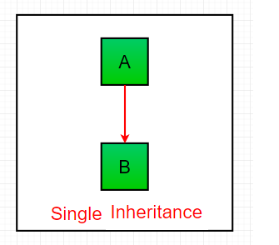
Single Inheritance

Slide 3
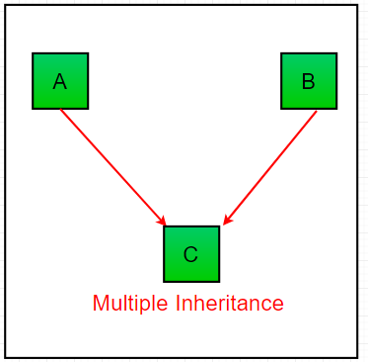
Multiple Inheritance

Slide 4
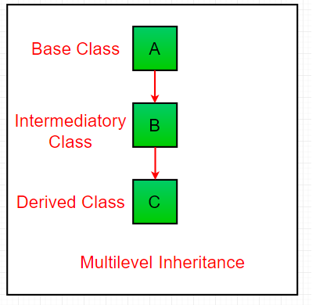
Multilevel Inheritance

Slide 5
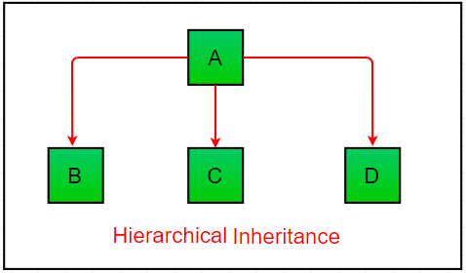
Hierarchical Inheritance

Slide 6
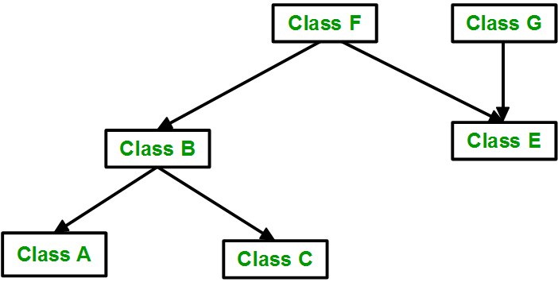
Hybrid Inheritance

Slide 7
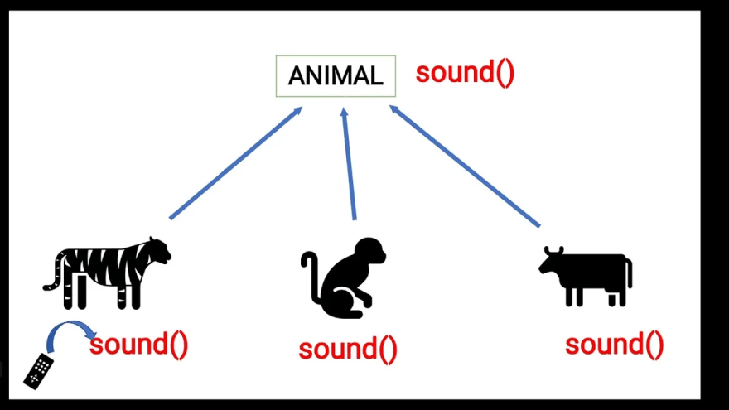
Polymorphism

Slide 8
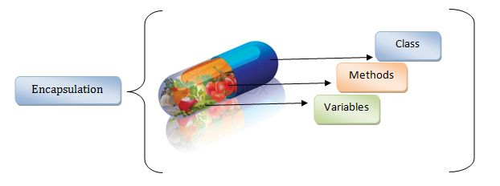
Encapsulation

Slide 9
Constructor
def __init__(self):
# body of the constructor

Slide 10
Destructor
def __del__(self):
# body of destructor

